Slide 1

MindWell: Your Daily Mental Wellness Companion
In a world of rising stress, MindWell offers accessible, personalized support for mental well-being, focusing on simplicity, privacy, and positive behavioral impact.
GitHub Repository Link: https://github.com/YuvrajBhalerao/MindWell-Mental-Wellness-App
Render Application Link: https://mindwell-mental-wellness-app.onrender.com/

Slide 2
Contributors
Manav Gite
Shashwat Mishra
Rituraj Singh Deora
Yuvraj Bhalerao
Contest Name: Ozibook Hiring Challenge June 2025
Team Name: Maharaj_Ki_Sena
GitHub Repository Link: https://github.com/YuvrajBhalerao/MindWell-Mental-Wellness-App
Render Application Link: https://mindwell-mental-wellness-app.onrender.com/

Slide 3



Understanding the Challenge
Rising Stress Levels
Global reports indicate a significant increase in stress and anxiety, particularly among younger demographics.
Limited Access to Support
Many individuals face barriers to professional mental health services, including cost and stigma.
Need for Digital Solutions
A convenient, private, and engaging digital platform can bridge this gap, offering immediate assistance.

Slide 4
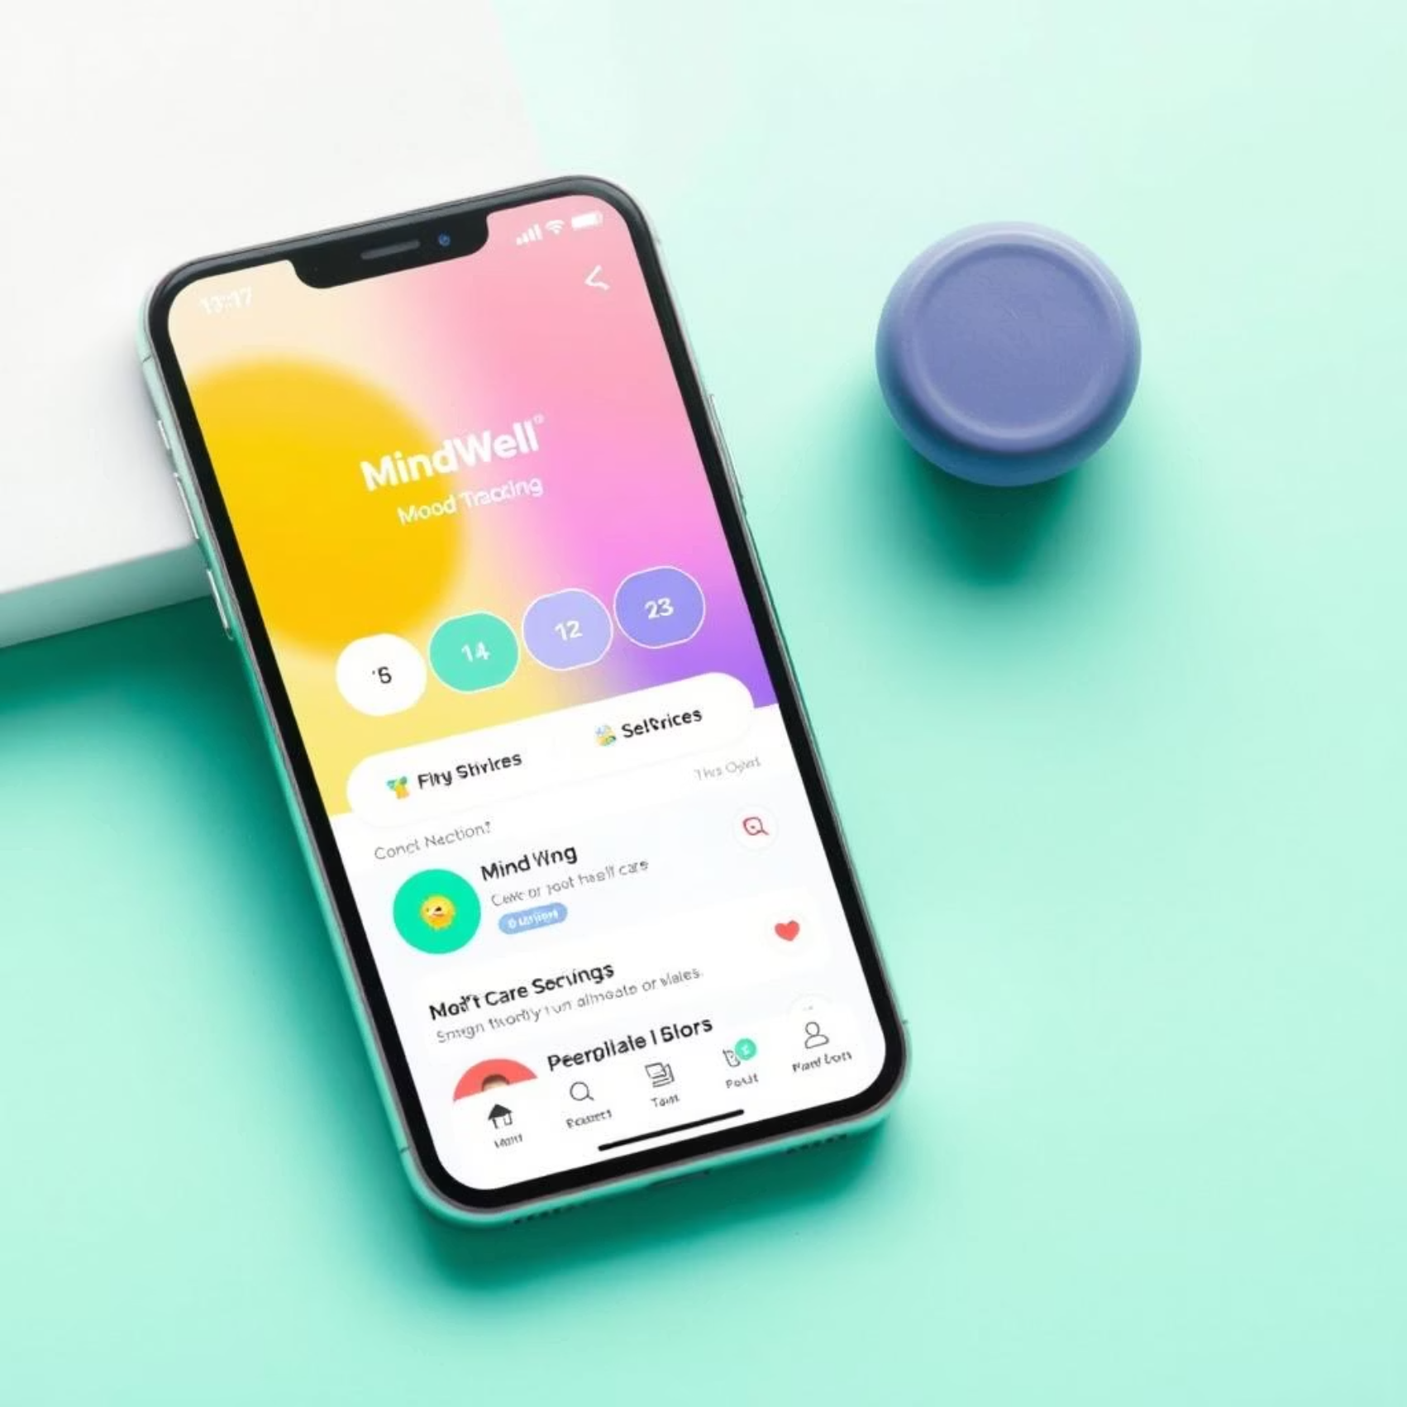
Introducing MindWell
MindWell is a comprehensive digital companion designed to empower users on their mental wellness journey.
Key Features
Daily Mood Check-ins
AI-Driven Activity Suggestions
Personalized Self-Care Routines
Anonymous Peer Support

Slide 5
Tech Stack Overview
⚙️ The project is lightweight, modular, and cloud-deployable — perfect for agile iteration and future scalability.
Layer | Technology Used
Frontend | HTML, CSS, JavaScript
Backend | Python with Flask (API Server)
Data Format | JSON (User mood & activity logs)
Deployment | Render Web Services (Auto-deploy from GitHub)
Storage | Local JSON (can scale to DB)

Slide 6



Personalized Self-Care with AI
MindWell's AI adapts to your unique needs, providing tailored suggestions to foster emotional resilience.
Mood Logging
AI Analysis
Activity Suggestions
Track daily emotional states with a simple, intuitive interface.
Our AI analyzes patterns to understand triggers and positive influences.
Receive personalized recommendations like breathing exercises or journaling prompts.

Slide 7

Community and Connection
Anonymous Peer Support
Connect with a supportive community in a safe and anonymous environment. Share experiences, offer encouragement, and find understanding without judgment.
Moderated forums
Shared coping strategies
Sense of belonging

Slide 8






Enhancing Engagement
MindWell incorporates innovative features to encourage consistent engagement and positive habit formation.
Gamification
Earn rewards and unlock new features by consistently engaging with self-care activities.
Wearable Integration
Sync with smartwatches to track biometric data, offering insights into stress levels and sleep patterns.
Progress Tracking
Visualize your journey with intuitive charts and graphs, celebrating milestones.

Slide 9
Our Commitment: Simplicity and Privacy
User-Centric Design
Data Security
MindWell prioritizes ease of use and a clean interface, ensuring a seamless and positive user experience.
Your privacy is paramount. All personal data is encrypted and anonymized, ensuring confidentiality and trust.
Intuitive navigation
End-to-end encryption
Minimalist aesthetics
Strict privacy policies
Accessible features for all
Anonymous interaction options

Slide 10
Market Gap & Target Users
🎯 Target Users
College Students dealing with academic pressure, isolation, and sleep issues
Young Working Professionals facing burnout, work-life imbalance, and emotional fatigue
First-time Therapy Seekers looking for a private, low-barrier entry into mental wellness
Existing Apps (e.g., Calm, Headspace) | MindWell Advantage
Focus on mindfulness/meditation only | Offers mood logging, AI suggestions, and peer support
Premium locked features | Fully accessible core functionality
Lacks emotional journaling | Journaling + AI analysis included
No peer community in many apps | Anonymous support system built-in
Limited personalization | Adaptive, AI-powered care suggestions
🧠 MindWell bridges the gap between traditional wellness apps and real, adaptive mental health support.

Slide 11
Future Roadmap
🛣️ What’s Next for MindWell?
Phase | Features
📱 Mobile App (Q3) | Flutter or React Native implementation for Android/iOS
🧠 AI Engine Upgrade (Q3-Q4) | Integrate real-time NLP models for journaling insights & mood forecasting
🔐 Authentication + DB (Q4) | Add login/signup, connect to Firebase or MongoDB for secure user data
🌍 Localization & Accessibility (Q4-Q1) | Multi-language support, screen reader-friendly UI, offline mode
👩‍⚕️ Expert Collaboration (Future) | Optional therapist insights, verified self-help resources
🚀 MindWell is not just a prototype — it's built with a vision to scale responsibly and empathetically.

Slide 12
Key Takeaways & Next Steps
Accessible Support
Personalized Wellness
Engaging & Secure
MindWell provides a much-needed, accessible mental health resource for everyone.
AI-driven insights and personalized routines empower users to take control of their well-being.
Gamification and robust privacy measures ensure a positive and trustworthy user experience.

